Slide 1
Text analysis in Python

Slide 2
Hello!
I am Weizhen Kong weizhenkong123@gwu.edu

Slide 3
Agenda
What is text analysis?
What is Natural Language Processing?
Applications of NLP
Steps of analysis
Practice on text and generate a word cloud

Slide 4
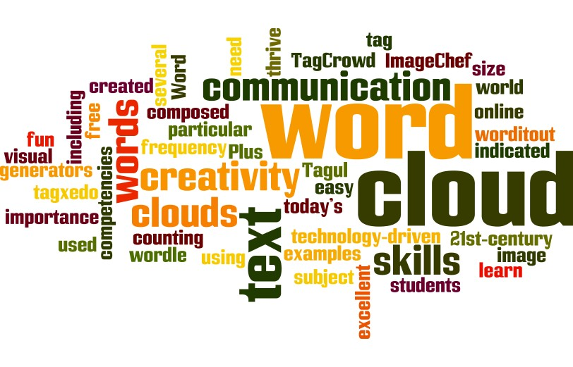
What is text analysis?
The process of deriving meaningful information from natural language text
Turn text into data for analysis via application of Natural Language Processing (NLP)

Slide 5
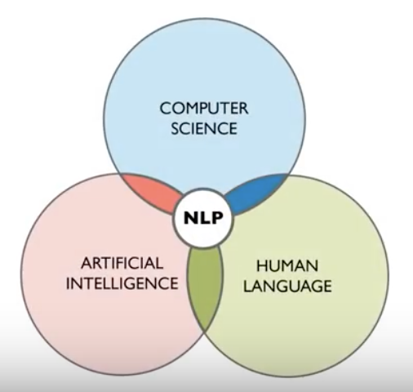
What is Natural Language Processing?
Part of computer science and artificial intelligence which deals with human languages.
Mapping into useful representation
Analyze different aspects
Text planning
Sentence planning
Text realization

Slide 6
Application of NLP
Sentimental analysis
Chatbot
Speech recognition
Machine translation
Spell check
Advertisement matching

Slide 7

Steps in analysis
Tokenization
Stop words
POS: Part of Speech
Stemming
Lemmatization

Slide 8
Tokenization
Break the sentence into words
Tokenization is the first step in NLP
Tokenization, is, the, first, step, in, NLP

Slide 9
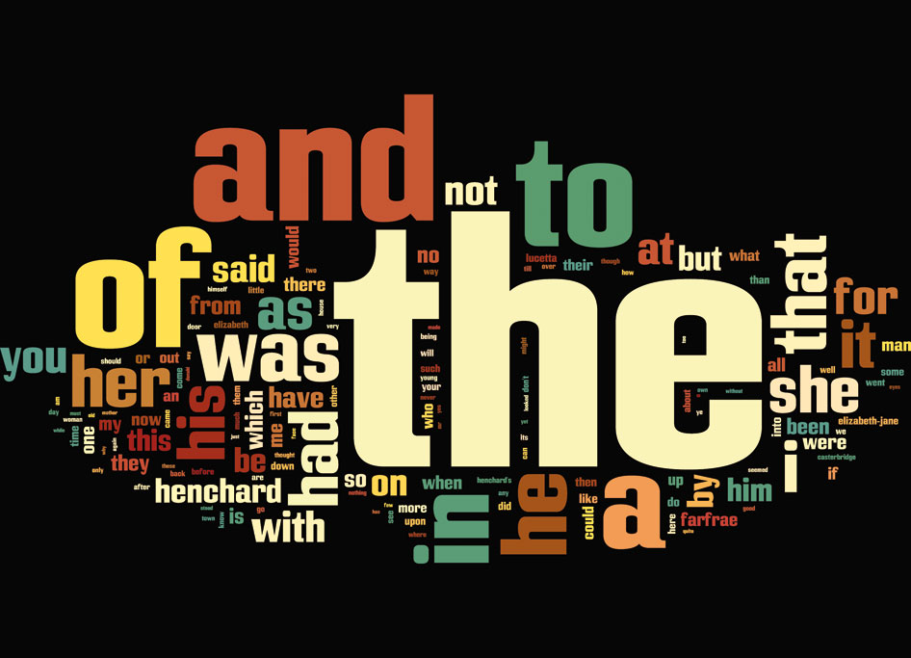
Stop words

Slide 10
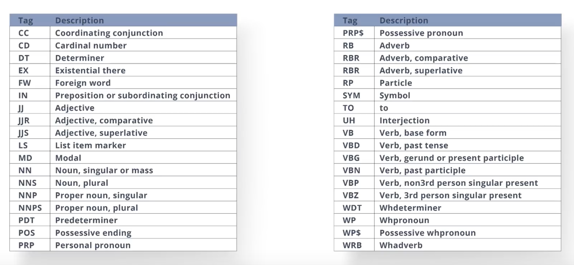
POS Parts of Speech
The POS works.
DT NN VBD

Slide 11
Stemming
Normalize words into its base form or root form
Affection, Affects, Affections, Affected, Affecting, Affectation
Affect
Lemmatization
Output is proper words
Gone, going, went ------ go

Slide 12
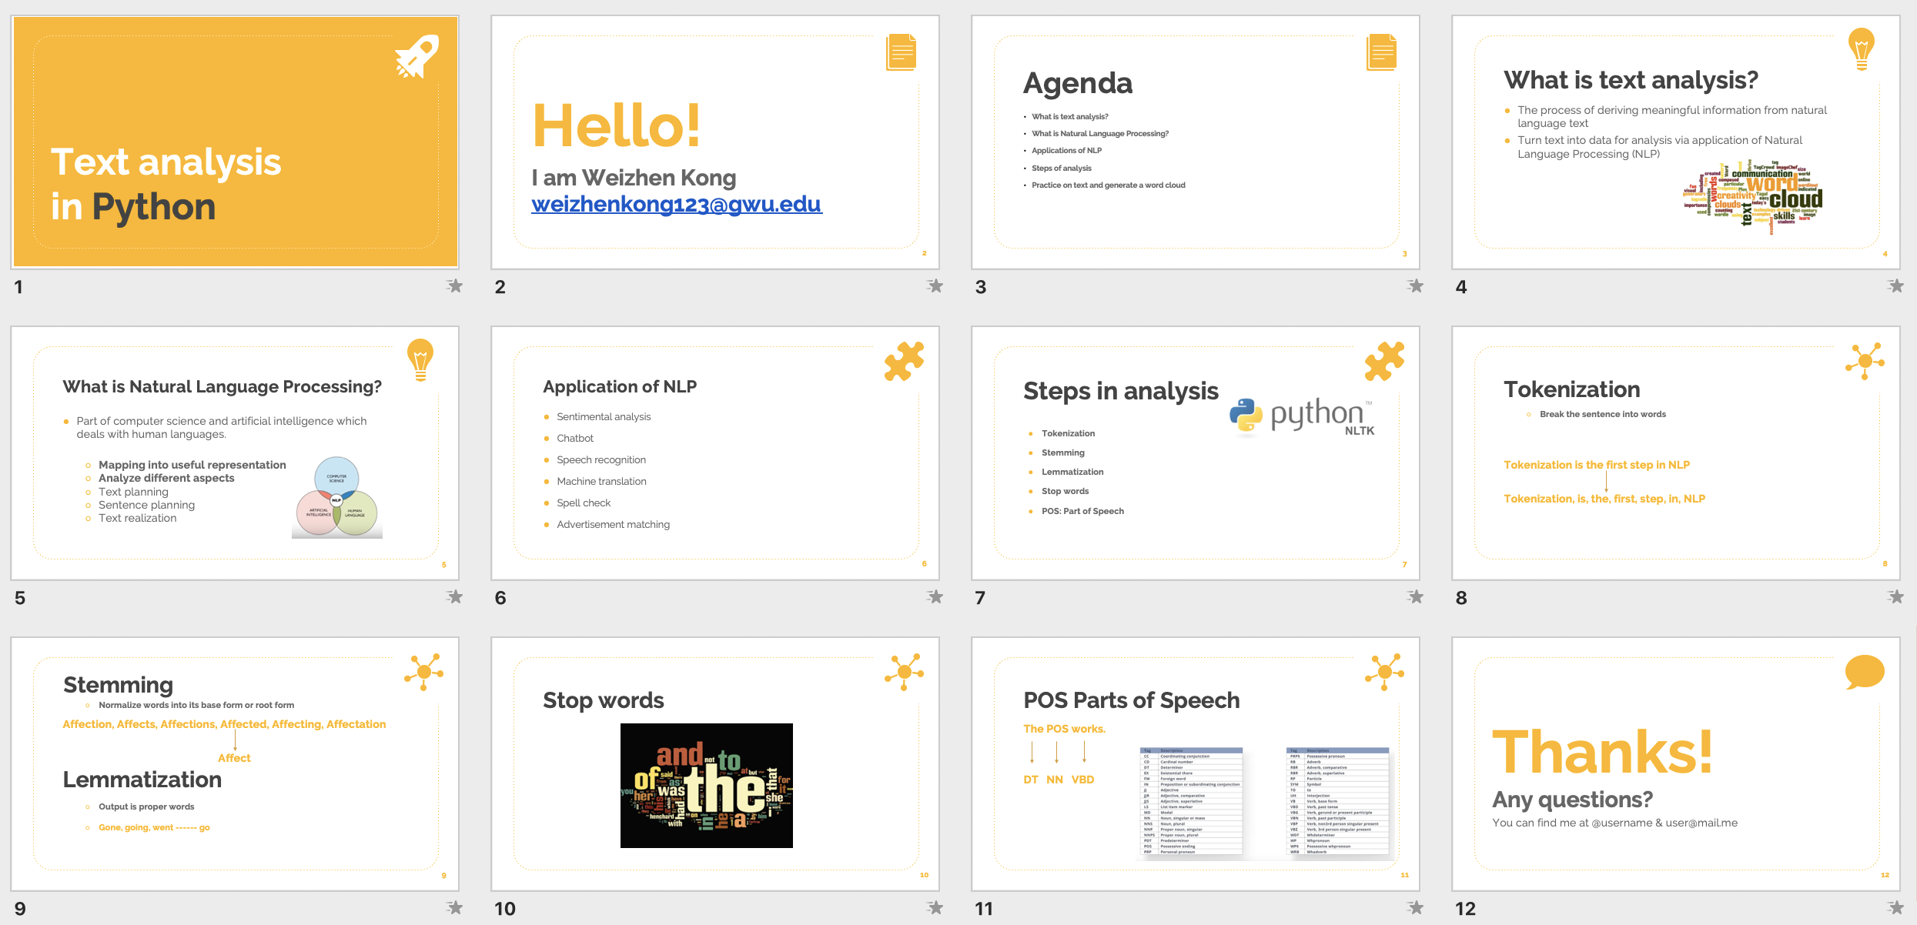

Slide 13
Thanks!
Any questions?
You can find materials at
https://github.com/gwu-libraries/gwlibraries-workshops/tree/master/text-analysis-python

